Slide 1

Introduction to Python - Part 6
List Comprehension

Slide 2
What is a list comprehension?
A list comprehension provides a concise way to create a list from another iterable
They consist of brackets containing the expression
It is possible to use conditions and loop in a list comprehension
The output is always a list

Slide 3
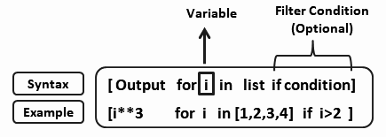
What is a list comprehension?
It consists of:
An output expression sequence
A for loop statement that iterates through the iterable
a conditional expression (optional)
output expression
input sequence

Slide 4
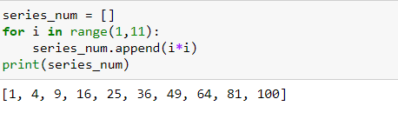

List comprehension vs loops
Creating a list using for loop
Creating a list using list comprehension
Create empty list and append squared values one by one using for loop
Create a list using list comprehension

Slide 5
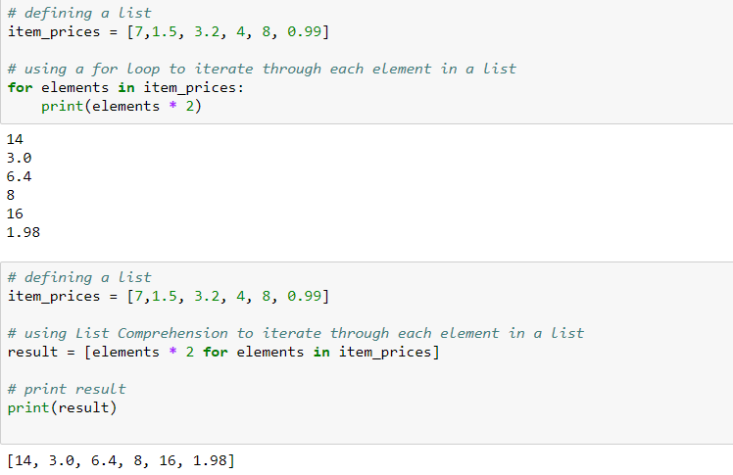
For loop in list comprehension

Slide 6
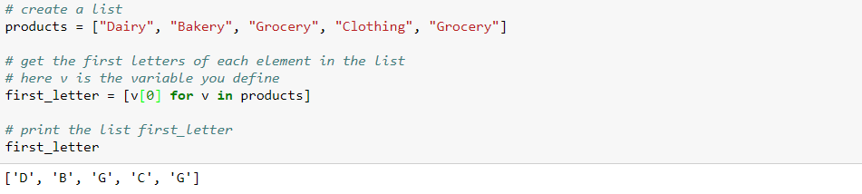
List comprehension : Examples
Reading first three letter of each word in a list

Slide 7
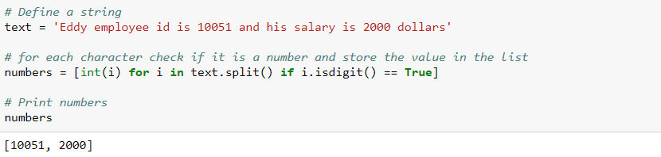
List comprehension : Examples
Extract all the numbers from the string using list comprehension

Slide 8
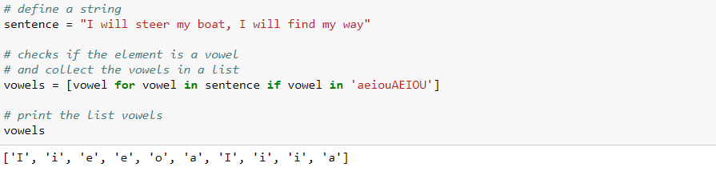
List comprehension : Examples
Extracting vowels from the string

Slide 9
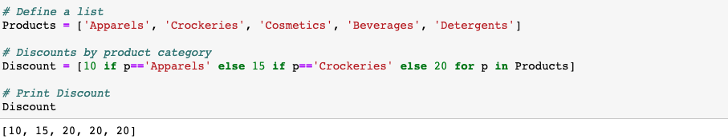
List comprehension : Examples
Using nested conditional statements in list comprehension

Slide 10
THANK YOU
Presenter’s Name
Contact Us
support@knowledgehut.com
Presenter’s Designation

